Slide 1

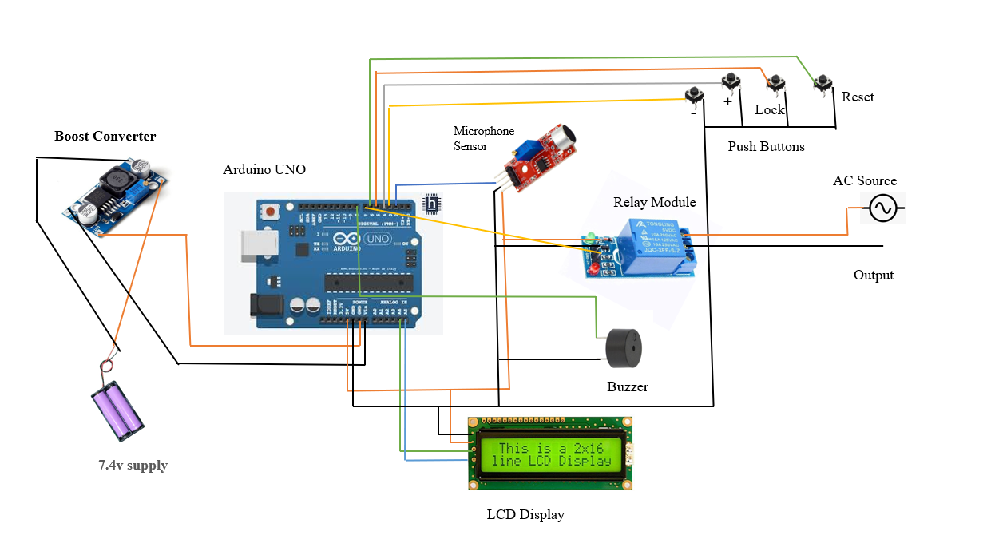
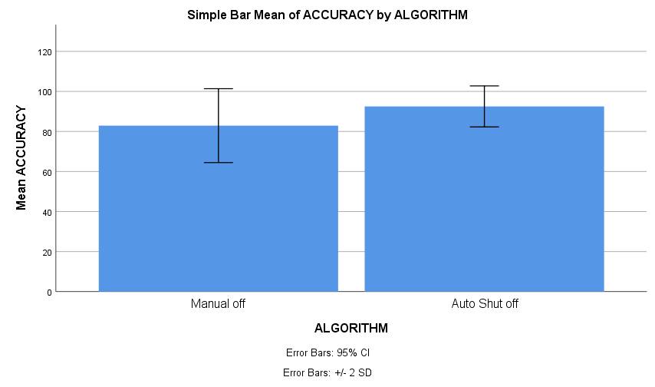
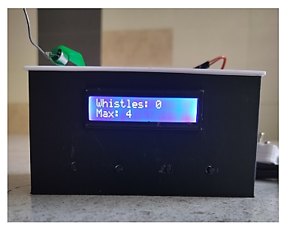
Students Name: T. MANI SAI LOKESH
Project Guide: Dr. Arjun Pandian
Register No: 192224105
Smart Cooker Whistle Counter With Auto Shut-Off
INTRODUCTION
The Smart Cooker Whistle Counter with Automatic Switch-Off is an innovative kitchen device designed to make pressure cooking easier and safer.
It automatically detects and counts cooker whistles using smart sensors and technology.
The system switches off the heat source automatically after reaching the preset whistle count, preventing overcooking and food wastage.
It provides audio and visual alerts through a buzzer and LCD display.
The device is useful for homes, hostels, restaurants, and smart kitchen environments. This device saves time, reduces energy consumption, and eliminates the need for continuous monitoring during cooking.
It is especially useful for busy individuals and modern households seeking convenience, safety, and accurate cooking results.
Future versions can include IoT connectivity, mobile app support, and voice assistant integration for smart home compatibility.
Even during a power cut, the LCD runs on battery backup, allowing the process to continue automatically when power returns.
Fig 1: Circuit Diagram of Smart Cooker Whistle Counter With Auto Shut-Off
MATERIALS AND METHODS
Arduino Board: Acts as the main microcontroller to process whistle detection signals and control the entire system operation.
Microphone Sensor: Detects the sound of pressure cooker whistles and sends signals to the Arduino for whistle counting.
Relay Module: Used to automatically switch off the stove or connected electrical supply after reaching the preset whistle count.
LCD Display: Displays the whistle count, system status, and user settings in real time for easy monitoring.
Buzzer System: Provides audio alerts when the required whistle count is reached or when the cooking process is completed.
Push Button Controls: Buttons such as SET, PLUS, MINUS, and RESET are used to configure whistle limits and control system functions.
Power Supply: Rechargeable battery or DC power source with boost converter supplies power to Arduino and all electronic components.
Switch: Allows manual ON/OFF control of the smart cooker whistle counter system.
Boost Converter: Regulates and stabilizes the power supply for smooth and reliable system performance.
Jumper Wires: Used for electrical connections between Arduino and other electronic components.
3-Pin Plug: Provides external power connection to operate the system safely.
RESULTS
 | Systems | N | Mean | Std. Deviation | Std. Error Mean
Efficiency | Manual off | 10 | 82.90 | 9.231 | 2.919
Efficiency | Auto Shut off | 10 | 92.50 | 5.126 | 1.621
Accuracy Values of Manual off and Auto Shut off
Comparing the Smart Cooker Whistle Counter with Auto Shut-Off and the traditional manual cooking method, each involving 10 iterations (N=10) by setting the G-Power of 80% (g power parameters configured with α = 0.05 and power = 0.85).
The Smart Cooker Whistle Counter with Auto Shut-Off and Manual Off method were evaluated with respect to accuracy. The Auto Shut-Off system achieved a higher mean accuracy (92.50% vs. 82.90%), along with a lower standard deviation and smaller standard error mean. These results demonstrate the superior accuracy, consistency, and reliability of the automatic whistle counting and shut-off system compared to the traditional manual method.
Fig.2:Comparison Between Manual off and Auto Shut off
DISCUSSION AND CONCLUSION
The Smart Cooker Whistle Counter with Auto Shut-Off successfully improved kitchen safety and cooking efficiency by automatically detecting cooker whistles and switching off the stove after the preset whistle count.
Features such as automatic whistle counting, LCD display monitoring, buzzer alerts, and auto shut-off functionality enhanced user convenience and reduced the need for continuous cooking supervision.
The integration of Arduino, microphone sensor, relay module, and buzzer system provided accurate whistle detection and reliable stove control, resulting in safer and more consistent cooking compared to traditional manual methods.
The compact design, low-cost implementation, and user-friendly operation make the system a practical and effective solution for households, students, working professionals, elderly users, and smart kitchen applications.
Fig 3: Smart Cooker Whistle Counter With Auto Shut-Off
BIBLIOGRAPHY
JK Adarsh, R. Kishore, and Arul Rajagopalan, “Pressure Cooker Whistle Notification Using Arduino Based Wireless Sensor Networks,” Journal of Physics: Conference Series, vol. 1969, no. 1, 2021.
Jeyanathan, Josephine Selle, et al. "An IoT-Enabled Whistle Counter System for Automated Monitoring and Control in the Cookers." 2025 5th International Conference on Trends in Material Science and Inventive Materials (ICTMIM). IEEE, 2025.
Alekhya, Samatham, et al. "Real-Time Pressure Cooker Whistle Detection and Alert System." 2025 5th International Conference on Soft Computing for Security Applications (ICSCSA). IEEE, 2025.
Adarsh, J. K., R. Kishore, and R. Arul. "Pressure cooker whistle notification using arduino based wireless sensor networks." Journal of Physics: Conference Series. Vol. 1969. No. 1. IOP Publishing, 2021.

